Slide 1
References
for undergraduate entry 2024
Updated Wednesday 29 March 2023

Slide 2
Using this deck
This presentation deck has been designed to support you through the changes to references for the 2024 cycle.
You can copy and paste them into your own materials and guides to support staff training and CPD.
We’ll continue to communicate key operational changes to you through our monthly newsletters. Please encourage all colleagues who advise applicants to sign up to receive them.
The deck will be updated as we monitor FAQs.

Slide 3
The Future of Undergraduate Admissions report builds on the findings of Reimagining UK Admissions from 2021. It highlights UCAS' continued engagement and ongoing progress with admission reform, including:
references
personal statements
grades on entry
personalisation
widening access and participation
Read the latest report, if you have any questions, comments or thoughts regarding potential reforms which you’d like to share with us, please email reform@ucas.ac.uk

Slide 4
Background to the changes
The reference is useful to share information about an applicant to help universities and colleges make selection decisions or plan support for a student post-enrolment.
University and colleges have told us in the current free text format it’s becoming challenging to meaningfully compare applicants using the academic references, as content varies significantly.
References can include long subjective descriptions of applicants, lengthy subject reports, or long descriptions of a centre’s achievements that offer little insight into the applicant.
This inconsistent approach is minimising potential for comparison, and significant time is being invested by advisers – but not always on what adds value.

Slide 5
Reference reform for 2024 entry
The free text approach is being replaced with three structured sections. These changes have been implemented following an extensive review with our advisory groups, including The Admissions Development Group, and broader validation with our key customer groups.
Key benefits:
Built-in clarity and confidence you are providing information that is useful.
You have more time and resources to allocate to students on the discovery/research phase of their application journey.
Universities and colleges can easily find information to make selection decisions and target support.
As with personal statements, contextual admissions and entry requirements, applicants and advisers are always advised to consider general guidance alongside any local information provided by universities and colleges.

Slide 6
‘The reference is most valuable where it is providing us with additional, contextual information about the student (especially where their educational journey has been, in any way, non-standard). There is considerable variation in what is included in the current reference so the hope is the reformed statement will be fairer to all applicants.’
Rob Evans,
Head of Admissions
University Of Sussex
‘References are there to reinforce what’s on that application form.
What we want are the exceptional circumstances that may surround an applicant. The new structure hopefully won’t take an adviser so long, it’ll be much shorter, much more succinct and we won’t miss anything.’
Kate Davidson,
Lead Admissions Officer
University of Aberdeen
‘Changing the reference structure to focus on a few core areas will help make the process more efficient for schools and colleges, ensuring you know exactly what we need you to include in your answer, so you can be safe in the knowledge you have included the most useful key additional information to document your student's educational journey. This also helps ensure the process is fair for applicants, as a consistent reference structure is followed for all.’
Sarah Allen, Acting Head Of Recruitment And Admissions, Arts University Plymouth​

Slide 7
UCAS registered centre linked applications
The following section is guidance for references for applications linked to a registered centre; either for full application management or reference only.
Applicants will need to enter a unique buzzword, set by the UCAS registered centre, in order to link an application.

Slide 8
Three section approach

Slide 9
Section 1: Enter a general statement about your school/college/centre.
Information could include:
context of your school, college or centre, e.g. performance, intake demographics, progression rates to higher education etc.
your portfolio of qualification provision and any restrictions on options students may have
information about your school, college or centre which may affect performance, such as significant staff changes, or damage to buildings
any policies or processes used for predicting grades (e.g. internal assessments). This is an opportunity to articulate any policy about not predicting grades for qualifications where the school or college feels the assessment method or qualification structure is not suited to predictions

Slide 10
Section 2: If applicable, enter any information about extenuating circumstances which may have impacted the applicant's education and achievement.
Include relevant information that contextualises the educational journey, for example:
individual circumstances – e.g. mature student, disability, serious, acute, or chronic illness, bereavement, significant adverse personal circumstances (with applicant consent)
context as to why there is a disparity between an individual’s grades achieved throughout the school or college (e.g. at GCSE/Scottish National 4/5 equivalent and predicted grades, where applicable)
factors which have limited the individual’s choice of subjects or load of study at UK Level 3 or equivalent (factors which have affected the whole centre rather than the individual should be included in section 1)
support the university or college should consider putting in place to ensure the applicant can thrive on their course (with applicant’s consent) – e.g. highlight the measures the school, college or centre put in place to ensure the student’s inclusion/experience
You must be clear whether any of the circumstances outlined in section 2 have already been considered by the student’s examination boards or awarding organisations for the qualifications taken.

Slide 11
Section 3 : Outline any other supportive information specific to the applicant and relevant to the course(s) applied for that you think universities/colleges should be aware of.
It is not necessary to craft the perfect paragraph here; providing short, clear, factual statements helps universities and colleges digest the information.
Useful information could include:
evidence of suitability for the course(s) applied for which may include performance and academic ability in relevant UK Level 3 or equivalent qualifications, relevant work experience, cases where an applicant is the strongest performer in their cohort, or extracurricular achievements
any barriers the applicant has faced in accessing work experience opportunities, only where relevant to the course applied to

Slide 12
Reference template in Centre management
If a staff member at your centre has entered reference template text in 'Centre management’ the information you enter in the template can be used to complete section 1 and added to each applicant reference in the Application details page.
If you update the reference template at any point the new template information will not update in the references you’ve already added the template to.
Only staff with permissions to manage a centre’s details in ‘Centre management’ will be able to add or edit the reference template.
Staff with ‘Application management’ permission to ‘edit’ references will be able to add the template in to individual references in the application details.

Slide 13
Centre management 2024
UCAS Training School
UCAS centre number: 19048

Slide 14
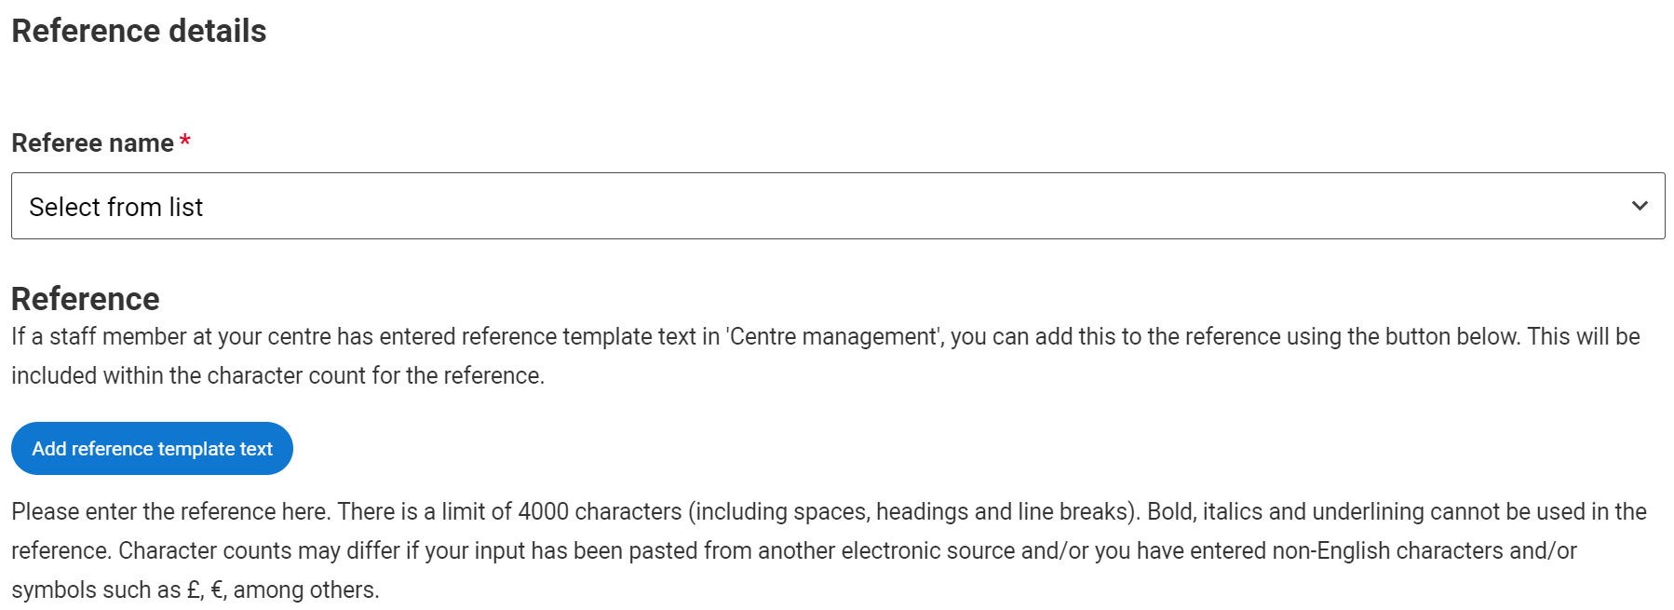

Slide 15
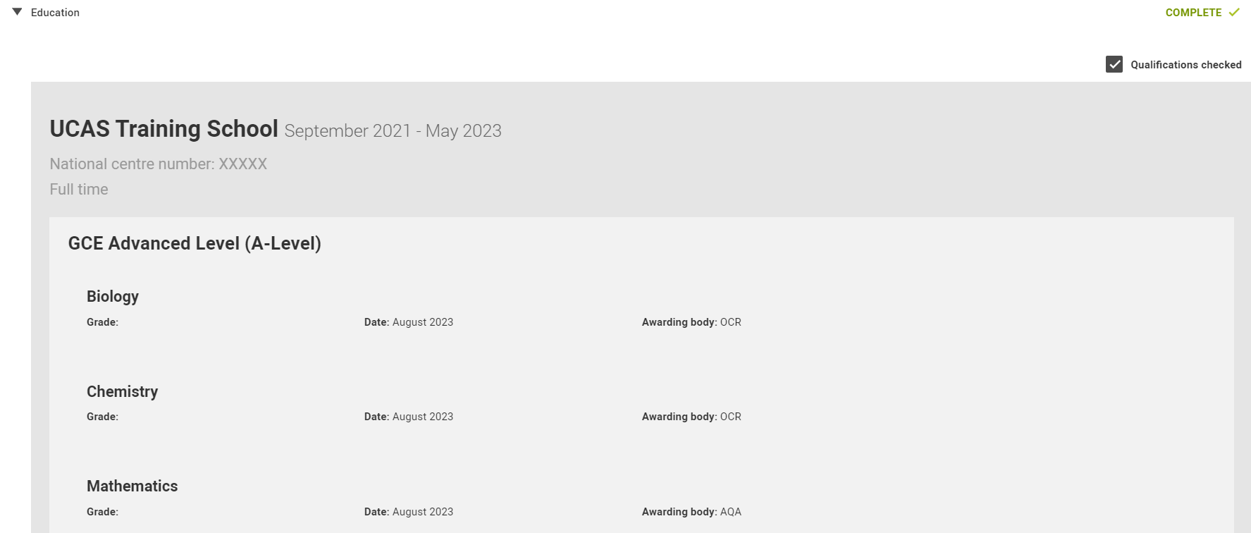
Tick the ‘Qualifications checked’ box if you have checked students’ qualifications. Leave blank if not checked.
This tick box
will continue to be seen by universities and colleges as
part of the reference.

Slide 16
References for independent applicants
The following section is for referees completing a reference for an independent applicant.
You’ll receive an email from UCAS with a password to allow you to input and submit this.

Slide 17
Three section approach
Section 1: Provide an overview of your relationship with the applicant (mandatory)
Section 2: If applicable, enter any information about extenuating circumstances which may have impacted the applicant's education and achievement.
Section 3: Outline any other supportive information specific to the applicant and relevant to the course(s) applied for that you think universities/colleges should be aware of.

Slide 18
Section 1: Provide an overview of your relationship with the applicant (mandatory).
Enter a general statement about how you know the applicant and the context of your relationship (e.g. employer, agent, private tutor, home-school tutor, professional).
Applicants who apply independently must ask for a reference from someone who isn’t a family member, friend, partner or ex-partner, and must not write it themselves.

Slide 19
Section 2: If applicable, enter any information about extenuating circumstances which may have impacted the applicant's education and achievement.
This could include:
individual circumstances – e.g. mature student, disability, serious, acute, or chronic illness, bereavement, significant adverse personal circumstances (with applicant consent)
context as to why there is a disparity between an individual’s grades achieved throughout the school or college (e.g. at GCSE/Scottish National 4/5 equivalent and predicted grades, where applicable)
factors which have limited the individual’s choice of subjects or load of study at UK Level 3 or equivalent
support the university or college should consider putting in place to ensure the applicant can thrive on their course (with applicant’s consent)
You must be clear whether any of the circumstances outlined in section 2 have already been considered by the student’s examination boards or awarding organisations for the qualifications taken.

Slide 20
Section 3: Outline any other supportive information specific to the applicant and relevant to the course(s) applied for that you think universities/colleges should be aware of.
It is not necessary to craft the perfect paragraph here; providing short, clear, factual statements helps universities and colleges digest the information. Applicants are encouraged to share details of their application with you so you can, where appropriate, comment on their chosen subject.
Useful information could include:
evidence of suitability for the course(s) applied for which may include performance and academic ability in relevant UK Level 3 or equivalent qualifications, relevant work experience, cases where an applicant is the strongest performer in their cohort, or extracurricular achievements
any barriers the applicant has faced in accessing work experience opportunities, only where relevant to the course applied to

Slide 21
Additional information
If you’ve been asked to be a referee for an independent applicant you’ll receive an email from us with a password, which allows you to input and submit your reference.
The applicant cannot submit their application to UCAS until a reference is attached.
What you’ll include in the reference will depend on how you know them, and how familiar you are with their plans and experience.
It’s a good idea to speak to them about their application before you write the reference.

Slide 22
Additional informational and guidance
This information and guidance applies to all references.

Slide 23
Characters and format
Total character count for the reference remains 4,000 characters. Please note, this includes spaces, line breaks and the new section headings.
The total count is for whole reference, there are no individual characters limits for individual sections.
Character counts may differ if your input has been pasted from another electronic source and/or you have entered non-English characters and/or symbols such as £, €, among others.
Bold, italics and underlining cannot be used in the reference.
All references must be written in English, unless the applicant is applying to Welsh universities or colleges and the rest of their application is completed in Welsh, in which case the reference can be written in Welsh.

Slide 24
Key information
When writing a reference for any applicant, including those outside the UK, please remember that under the Data Protection Act 2018 the applicant can ask for a copy of the reference and any other personal information we have about them.
Ticking ‘no information to enter’ for this section in the adviser portal will highlight to universities and colleges that no information has been supplied under these headings.
Don’t forget, the reference is not your only opportunity to provide information about your applicants. Universities and colleges welcome further dialogue with referees and would urge schools and colleges to inform them of any changes to the applicant’s profile or circumstances that occur after the point of application.

Slide 25
Further information
Please ensure you sign up for UCAS updates to be kept up-to-date with the latest advice and guidance.

Slide 26
Information and guidance for advisers
Monthly newsletters
Advisers can stay up-to-date with all the latest news and guidance by signing up at ucas.com/adviser-updates.
Adviser Live sessions
Our regular live studio sessions feature expert speakers from different sectors exploring all student pathways. Take a look at our upcoming events on ucas.com/adviser-lives.
Training and conferences
We host dedicated events, conferences, and professional development sessions for teachers and advisers right across the year – everything needed to help advisers help their students: ucas.com/advisers/training.
ucas.com/advisers
There is a dedicated area for advisers on ucas.com. Here you’ll find all our latest news, events, and a variety of guides and resources to help plan career guidance sessions and provide support throughout the whole application cycle: ucas.com/advisers.

