Slide 1
Parents evening presentation
Last updated April 2023

Slide 2
What is UCAS?
UCAS is an independent charity providing information, advice and admissions services. We’re there to help people discover what their next step might be.
UCAS does:
UCAS doesn’t:
provide information, advice, and support
process applications
complete fraud and verification checks
take part in education sector engagement
make decisions or offers
set entry requirements
advise on finance
advise on immigration or visas for individuals

Slide 3
What Next? What are the options available?

Slide 4
Choices available
Higher education
Apprenticeships
Studying abroad
Gap year
Getting a job
Register for the UCAS Hub to understand the options available and make choices that are right for you: ucas.com/hub
Security marking: PUBLIC
09 May 2023
| 4

Slide 5
Why continue in education?
Essential for some career paths.
Develop new transferable skills and subject knowledge.
Increase confidence and independence.
Broaden experiences.
Meet new people.
Investment in the future.
Increased job prospects.
Higher earning potential.

Slide 6
What are the options?
Certificate of Higher Education (CertHE) and Diploma of Higher Education (DipHE): first and second year of a degree course.
Higher National Certificate (HNC) and Higher National Diploma (HND): HNC is a one-year industry specific course, and the HND is a two-year industry specific course.
Higher apprenticeships: provide an opportunity to gain Level 4 qualifications or above, e.g. HND, or foundation degree while you work. Can take from one to five years to complete, depending on the course level.
Foundation degree: flexible vocational qualification, combining both academic study and workplace learning. It usually takes two years to complete.
Bachelor’s or undergraduate degree: a three to four-year course which can also be available as a part-time option, allowing you to study and work.
Degree apprenticeships: enable you to gain a full undergraduate or master’s degree while you work. Degree apprenticeships take three to six years to complete, depending on the course.

Slide 7
What’s right?
There are a number of things to consider with your next step :
something you enjoy – you are investing time and effort
whether it’s right for your career path – check with employers and professional organisations
location – city or rural, transport links
a study and assessment style that suits you
environment including extracurricular, clubs, and societies
finances

Slide 8
University or college What’s right for you?

Slide 9
Choosing the right place
Style – from traditional, with a focus on subject-based courses and research, to modern universities/colleges, with a greater focus on vocational courses.
Location – some are in large cities, others in small towns, by the coast or in the countryside – it’s all a major influence on the environment and lifestyle.
Size – larger universities can have more than 20,000 students, whereas some of the smallest have only a few thousand.
Culture and facilities – influenced by a range of factors, including the diversity of students who attend.
What graduates do – all universities collect destination statistics; it can be useful to find out what jobs or further study students go on to.
Tuition fees – can vary between universities and colleges; check if there are scholarships or bursaries available.
Living costs – accommodation, transport, and food can vary enormously.

Slide 10
Choosing the right course
What does the course cover?
Courses with the same title may be very different.
Look carefully at the core course content, and the range of optional studies/modules available.
Which modules are the most interesting and relevant to your career aspirations?
See if the course or university/college offers any internship, placement, or study abroad opportunities.
How is the course taught – structured teaching, or more independent research? How many lectures are there, and how much group work will be done in seminars?
How is the course assessed?

Slide 11
UCAS Hub Your discovery tool

Slide 12
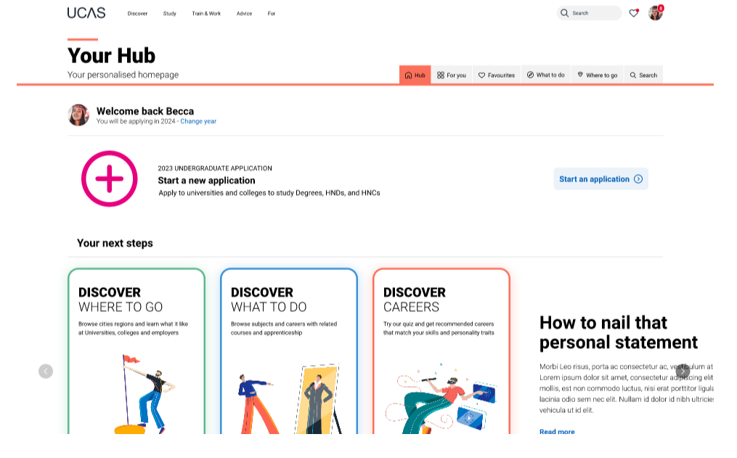
Starting your research
Register with the UCAS Hub to:
explore careers, subjects, places, and apprenticeships
find and favourite over 35,000 courses
search for open days, events and virtual tours
turn predicted grades into UCAS Tariff points
speak to those in the know using Unibuddy
speak to career, higher education, and application specialists by attending Hub lives
take the UCAS Quiz to find your career matches
start your application

Slide 13
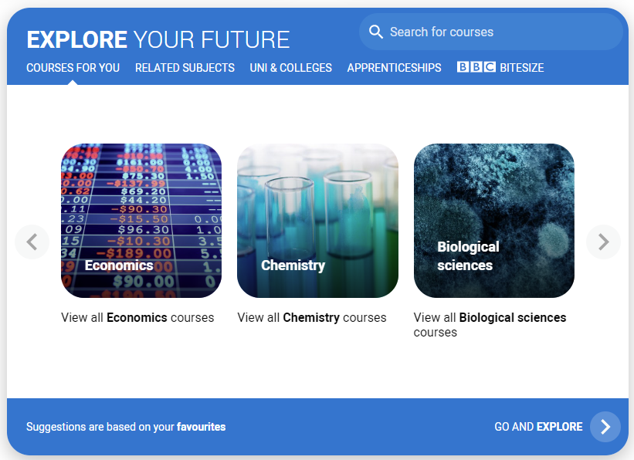
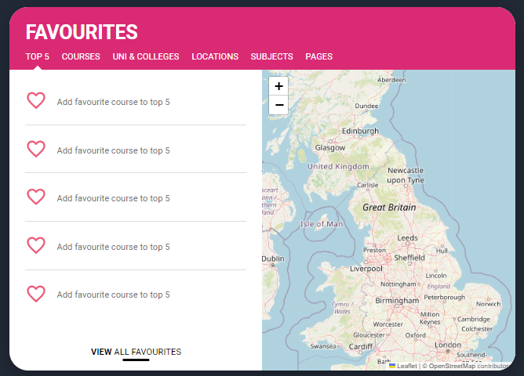
Personalised tools to help
Tools to help
Explore your future
Discover what to do with subject, industry, and career guides; discover where to go with city, employer and accommodation information. Explore apprenticeships and course opportunities for you. Favourite as you go.
Your favourites
Search for courses, use to decide your top 5 choices, manage, keep those favourite information pages to hand. Manage and edit at any time.
Security marking: PUBLIC
09 May 2023
| 13

Slide 14
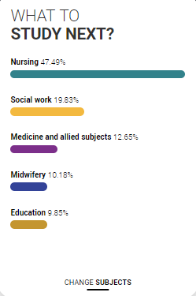
Personalised tools to help
UCAS Quiz
Find job and career ideas matched to your personality.
Plus a list of courses previous students studied in order to get there.
What to study next?
Broaden your horizons by exploring another subject area, that student’s who did your qualification went on to study.

Slide 15
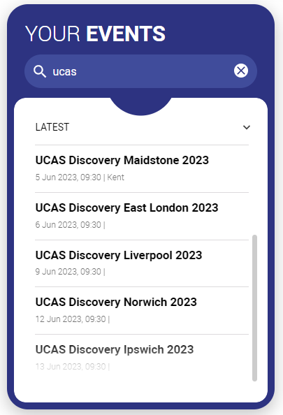
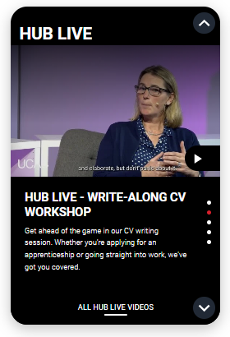
Our advice and events
UCAS Hub lives
Join our live sessions hosted by expert panels.
Ask questions to help you make an informed decision about the right path for you. University, apprenticeships or the world of work.
UCAS Discovery
Events and open days are presented based on your preferences.
Register straight from the Hub for our UCAS Discovery ‘The Big Q&A Tour’, with exciting new zones covering all pathways.

Slide 16
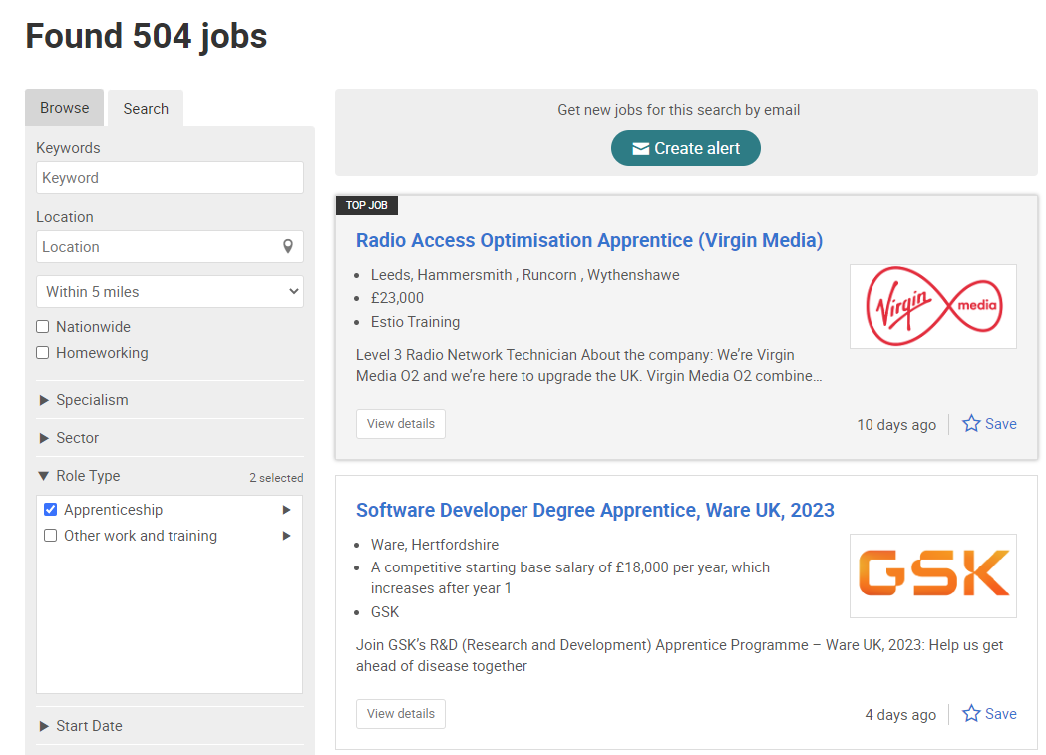
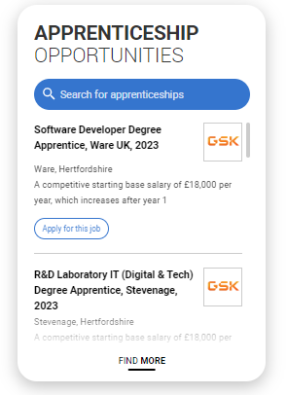
UCAS Exploring Apprenticeships
From UCAS Hub you can easily explore apprenticeships; learn more information and see a live selection of apprenticeship vacancies.
Set alerts to stay up to date.

Slide 17
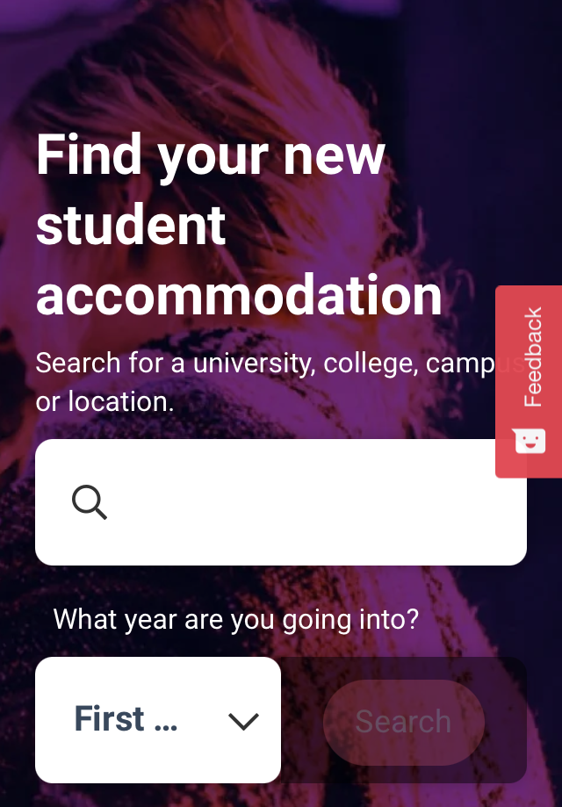
What else do you need?
Accommodation
High on the list when considering where to study, but it’s not always easy to compare what’s on offer. Understand what options there are using our accommodation search.
Personal Statement Builder
Designed to help you think about what to include, and how to lay it all out. It counts how many characters you’ve used, so it’s easy to see when you’re close to the 4,000 character limit.

Slide 18
Apprenticeships What you need to know
www.ucas.com/apprenticeships

Slide 19
Apprenticeships
Study
Job
Wage*
What are
apprenticeships?
www.ucas.com/apprenticeships
* Foundation apprenticeships in Scotland are unpaid

Slide 20
The A – Z of apprenticeships
There are over 600 possible apprenticeship 'standards' (training programmes) which exist. It’s probably easier to name an industry that doesn’t have an apprenticeship then to list all that do. Here are just a few ….
Accounting and Taxation
Architect
Boat Builder
Building Surveyors
Civil Engineer
Cyber Security Technician
Data Analyst
Doctor (from 2023)
Early Years
Ecologist
Farrier
Food Technologist
Game Programmer
Geospatial mapping
Harbour Master
Historic Environment Adviser
Internal audit professional
Intelligence analyst
Journalist
Junior 2D artist (visual effects)
Knitted product manufacturing
Laboratory scientist
Licensed conveyor
Midwife
Marketing Manager
Nuclear Scientist and Engineer
Nursing
Operational firefighter
Orthodontic therapist
Paralegal
Physiotherapist
Quality practitioner
Rail engineer
Research scientist
Social worker
Software Developer
Teacher
Town planning assistant
Utilities engineering
Veterinary nurse
Vehicle damage assessor
Water process technician
Workplace pensions consultant
Youth worker
www.apprenticeships.gov.uk/#

Slide 21
What am I doing now?
Apprenticeships work in levels too!
For example in England, Northern Ireland and Wales:
In England:
Level 2
Intermediate Apprenticeship
Level 3
Advanced Apprenticeship
Level 4-7
Higher Apprenticeship
GCSE grade 9-4 is a
Level 2 qualification
In Wales:
Level 2
Foundation Apprenticeship
Level 3
Apprenticeship
Levels 4-7
Higher Apprenticeship
A level or T level is a
Level 3 qualification
In Northern Ireland:
Did you know?
An apprenticeship offering a degree may also be called a Level 6 or Higher Apprenticeship
Level 2
Level 2 Apprenticeship
Level 3
Level 3 Apprenticeship
Level 4-7
Higher Apprenticeship

Slide 22
What am I doing now?
Apprenticeships work in levels in Scotland too
For example in Scotland:
SCQF Level 4-6
Foundation Apprenticeship
Scottish National Level 5 is a
SCQF Level 5 qualification
SCQF Levels 5+
Modern Apprenticeship
SCQF Level 8-11
Graduate Apprenticeship
Scottish Higher is a
SCQF Level 6 qualification

Slide 23
Who can start an
Apprenticeship?
Anyone 16 and over
Anyone not in full time education*
Apprenticeships in Scotland, Wales or England require you to be living in the same country as the apprenticeship
Apprenticeships in Northern Ireland require you:
be employed or be about to take up paid employment in Northern Ireland
be working a minimum of 21 hours per week on a permanent contract
* a foundation apprenticeship in Scotland is typically taken alongside Scottish Higher and National 5s

Slide 24
When can I apply?
Not one deadline
Advertised throughout the year
Larger organisations with multiple application processes may recruit earlier than smaller local organisations
Higher apprenticeships with a Sep/Oct start tend to recruit in the previous academic year
www.ucas.com/apprenticeships

Slide 25
How can I apply?
Applications are made directly through the company or the education provider.
There is no limit on the number of applications you can make.
The application process might vary across vacancies, you could be asked for:
CV and Covering Letter
Application Form
In App/Site application
You can apply for universities and apprenticeships at the same time!

Slide 26
UCAS Exploring Apprenticeships
From UCAS Hub you can easily explore apprenticeships; learn more information and see a live selection of apprenticeship vacancies.
Set alerts to stay up to date.

Slide 27
UCAS Applications How to apply

Slide 28
Completing the UCAS application
Student registers for a UCAS Hub account to carry out research and start application.
Student completes all sections of the application and sends it to their school/college.
Teacher or adviser reviews the application and adds reference and predicted grades.
Applications are sent to UCAS by the school or college on behalf of the student.
Universities and colleges make their decisions on the application.
Security marking: PUBLIC
09 May 2023
| 28

Slide 29
When to apply for 2024 entry
16 May
UCAS Undergraduate application opens for 2024 entry.
5 September
First day UCAS can receive a completed application to process.
16 October
UCAS application deadline for courses in medicine, veterinary medicine/science, and dentistry, and courses at Oxford or Cambridge.
31 January 2024
UCAS equal consideration application deadline.
28 February
UCAS Extra opens.
30 June
Last date for applications before Clearing opens.
2 May 2023
UCAS search tool displays 2024 courses.
5 July
Clearing opens.
Security marking: PUBLIC
09 May 2023
| 29

Slide 30
Key facts
To start an application you need to register with ucas.com, you can register at any time.
From 16 May 2023 you’ll be able to start an application.
Universities and colleges can’t see your other choices when you apply.
Apply by the equal consideration date.
You have up to five choices, unless applying to study medicine, veterinary, medicine/science, dentistry – then it’s four choices.
You can’t apply to BOTH Oxford and Cambridge.
Applying costs £27.50.

Slide 31
Linking to a school
If you’re applying with the help of a school, college or centre you should enter their ‘buzzword’ to link your application to them.
The buzzword is a unique code set by your school, college or centre.
By linking your application you’re giving your school, college or centre permission to view and track your application.
It also means they’ll provide you with a reference, and send your application to UCAS on your behalf.

Slide 32
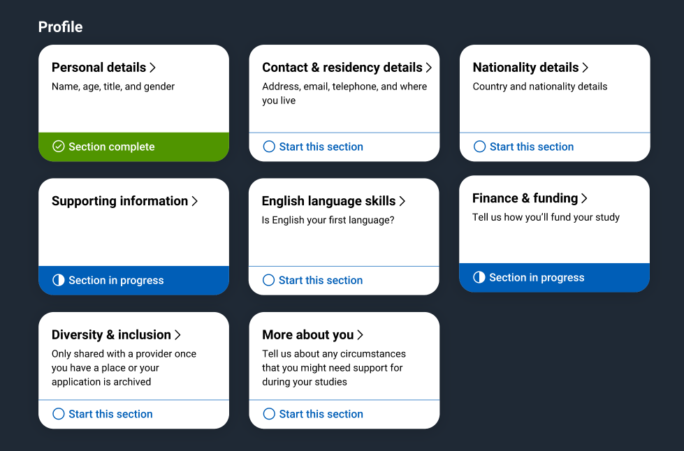
Application
Profile:
Personal details
Contact and residency details
Nationality details
Supporting information
English language skills
Finance and funding
Diversity and inclusion*
More about you
* (for students with a UK home address)
Security marking: PUBLIC
09 May 2023
| 32

Slide 33
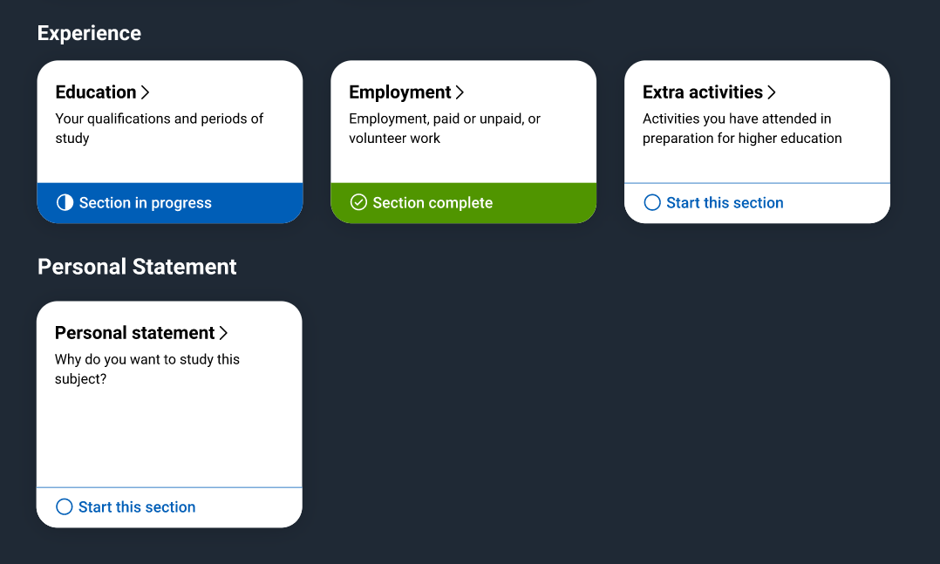
Application
Experiences:
Education
Employment
Extra activities*
Personal statement
Reference**
Add choices – up to five
*(for students with a UK home address)
**(not visible for students linked to their school/college)

Slide 34
The personal statement
The only section you have full control over
Your only chance to market yourself as an individual
The same for all of your choices
UCAS’ similarity detection service:
every personal statement is run through software to check for plagiarism.
A maximum of 4,000 characters, or 47 lines
A minimum of 1,000 characters
There isn’t a spelling or grammar check
No formatting allowed
Security marking: PUBLIC
09 May 2023
| 34

Slide 35
Start early
Include:
academic achievements, past and present
interest in the course area
knowledge of the subject area
enthusiasm to go beyond the syllabus
details of independent study skills
Security marking: PUBLIC
09 May 2023
| 35

Slide 36
Consider…
Universities and colleges will consider:
Have you chosen the course for the right reasons?
Can you achieve in a new learning environment?
Do you have a range of interests and aptitudes?
Do you have a depth of interest in the subject?
Have you studied independently?
Do you appear motivated and committed?
Do you have good numeracy and literacy skills?
Security marking: PUBLIC
09 May 2023
| 36

Slide 37
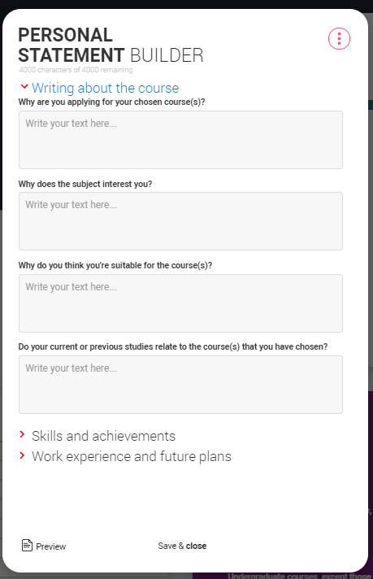
Security marking: PUBLIC
09 May 2023
| 37

Slide 38
Decisions
Universities and colleges will review the:
They may also ask for:
personal statement
admissions test
qualifications
interview
reference
portfolio/audition
Security marking: PUBLIC
09 May 2023
| 38

Slide 39
Tracking your application
Follow your application 24/7:
see your choices
keep personal information up to date
view and reply to your offers
You’ll receive one of three decisions from your choices:
unconditional offer
conditional offer
unsuccessful
Security marking: PUBLIC
09 May 2023
| 39

Slide 40
Replies to offers
Once you have decisions on all your choices, you can choose two:
One as a ‘firm’ acceptance – your first choice.
The other as an ‘insurance’ acceptance. This acts as a back-up if you do not get into your ‘firm’ choice.
Any remaining offers must be declined.
Once all your decisions and replies have been made, if you are not holding an offer, you may be able to use Extra or Clearing to find available places.
Security marking: PUBLIC
09 May 2023
| 40

Slide 41
Other options
Extra (28 Feb – 4 Jul)
Used all five choices and had no offers.
Add Extra choices for consideration one at a time.
Clearing (5 Jul – Oct)
Apply after 30 June, receive no offers, decline all offers, not met conditions.
Find vacancies from 5 July and add a Clearing choice to your application.
Security marking: PUBLIC
09 May 2023
| 41

Slide 42
Next steps

Slide 43
What can students be doing?
research, research, research
attend open days and events
extracurricular and super curricular activities
work experience
volunteering
independent learning outside the curriculum
focus on this year’s studies
Security marking: PUBLIC
09 May 2023
| 43

Slide 44
Keeping you informed
www.ucas.com/parents
Sign up for our parents newsletter
Read our guides just for you.

Slide 45
Our support
@ucas_online
UCAS Customer Experience Centre:
0371 468 0 468
From outside the UK:
+44 330 3330 230
Monday to Friday
08:30 – 18:00 (UK time)
@ucas_online
@ucas_online
@ucas
@UCASonline
Security marking: PUBLIC
09 May 2023
| 45
Security marking: PUBLIC
09 May 2023
| 45

Slide 46
Thank you
Security marking: PUBLIC
09 May 2023
| 46

